Slide 1
PG MANAGEMENT SYSTEM USING JAVA FULL STACK

Slide 2
COURSE LEARNING OBJECTIVES:
Objective | Statement
1 | Define the basics of Object-Oriented Programming concepts
2 | Discuss the use of inheritance, interfaces, packages, and exception handling.
3 | Apply event handling and multithreading in GUI-based applications.
4 | Evaluate the effectiveness of object-oriented design principles in solving programming problems using Java.
5 | Compare the use of interfaces and abstract classes in Java and identify suitable contexts for their application.
6 | Design GUI-based applications using AWT/Swing components with event-driven programming in Java.

Slide 3
COURSE OUTCOMES:
COs | Statement
 | Learners will be able to:
CO1 | Identify real-world problems and analyze requirements that can be addressed using Java programming and object-oriented principles.
CO2 | Design modular and scalable Java solutions using classes, inheritance, interfaces, and exception handling to solve the identified problem.
CO3 | Develop a Java application that integrates GUI (AWT/Swing), multithreading, collections, and file/database operations as per the project scope.
CO4 | Evaluate the functionality, usability, and performance of the Java-based solution, and demonstrate effective teamwork and communication during project execution and presentation.

Slide 4
PROBLEM STATEMENT:
The current paying guest (PG) accommodation market faces several
challenges.
There is no straightforward way for users to assess the safety of PG locations causing safety concerns.
Information about facilities, maintenance, and pricing is often incomplete or unclear.
The booking process can be slow and unreliable.
Many platforms lack secure and convenient online payment options.
Maintenance issues are also difficult to report and track.
Fixed pricing models do not respond well to demand fluctuations.
These challenges reduce trust and confidence, indicating the need for a modern, transparent, and user-friendly platform.

Slide 5
SOLUTION:
We will develop a Java-powered platform for easy and trustworthy PG booking and reviews.
The website will feature location-based safety indexes to enhance user confidence.
It will offer secure online payment options for hassle-free transactions.
A maintenance request system will allow tenants to report and track issues efficiently.
Dynamic pricing will help optimize rent based on demand and market trends.

Slide 6
OBJECTIVES:
MILESTONES:
Requirement Analysis & Planning
UI/UX Design and Wireframes
Java Backend Development
Integration of Location-Based Search & Safety Indexes
Secure Online Payments Implementation
Dynamic Pricing Module Integration
Maintenance Request System Implementation
QA, Testing, and Feedback Incorporation
Public Launch & Marketing
Enhance transparency and trust in the PG rental process.
Improve user safety through data-driven safety indexes.
Provide secure, smooth online
booking and payment experiences.
Facilitate instant digital
maintenance requests and issue tracking.
Enable flexible, competitive
pricing tailored to market demand.

Slide 7
EXPECTED OUTCOMES:
INNOVATIVE FEATURES:
Location-based PG discovery and search
Safety Index visualization for each area
End-to-end secure online payments
Integrated maintenance request and tracking system
Automated dynamic pricing system
Seamless booking and review process for users and PG owners.
High safety assurance via location scoring.
Fast, secure online payment flows.
Simplified, trackable maintenance requests.
Data-driven, competitive PG pricing to maximize occupancy and revenue.

Slide 8
ARCHITECTURE DIAGRAM:
Start
Login / Signup
Search PGs
View PG Details
Advanced Features:
Verified Owner Profile
Location – Based Safety Index
Maintenance Request System
Book PG
Confirmation
End
8

Slide 9
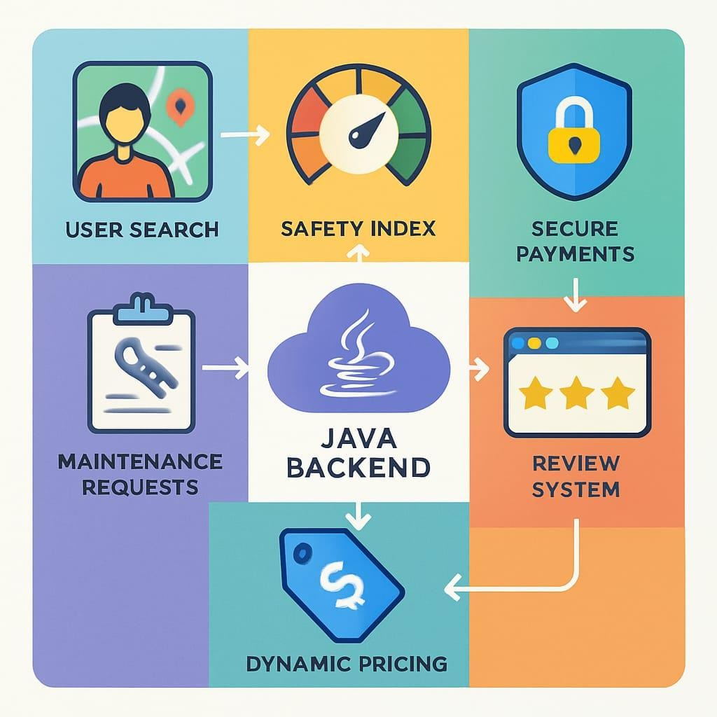
DIAGRAMMATIC REPRESENTATION:

Slide 10
PROJECT OVERVIEW
The Verified PG Connect Website allows users to browse and book PG accommodations online. The system consists of two main modules — one for PG owners to register and list their properties, and another for tenants to explore and book based on verified details. It includes features such as:
Verified property listings with photos and amenities.
Advanced search and filter option.
Booking form with customer details.
Review and feedback system.
The overall goal is to create a trustworthy and convenient platform that enhances user experience and builds confidence in online PG booking.

Slide 11
KEY FEATURES AND INFERENCE
From the survey of existing systems and literature, the following key findings were observed:
Existing PG accommodation systems face several challenges, including a lack of proper verification for users and properties, which leads to fake or misleading listings.
Most platforms are designed for general rentals rather than PG-specific needs, making them unsuitable for students and working professionals seeking shared spaces.
Users often depend on brokers, raising costs and reducing transparency. Additionally, poor data authenticity and the absence of features like reviews or chats limit user trust and interaction.
Overall, there is a clear need for transparent, verified, and user-friendly PG platforms that offer secure bookings, authentic data, and improved engagement between owners and tenants

Slide 12
Inference
There is a significant research and practical gap in providing a verified, centralized, and user-
friendly PG accommodation platform. These findings justify the development of the Verified
PG Connect Website, which focuses on verification, transparency, and reliability — areas that have not been fully addressed in prior works.

Slide 13
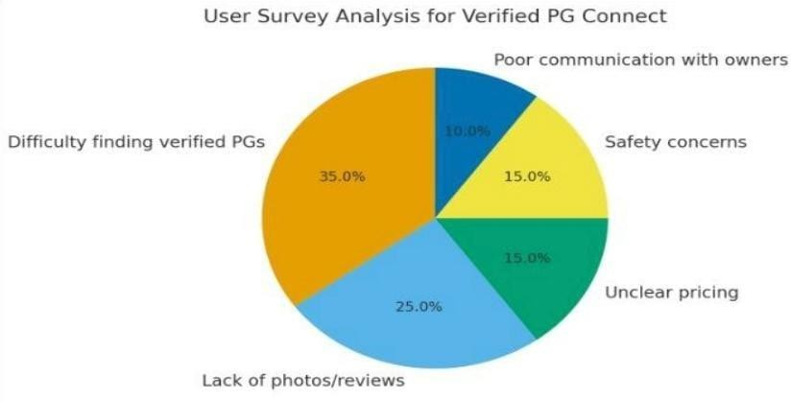
USER SURVEY AND ANALYSIS
To understand the needs of the users, a survey was conducted among college students, working professionals, and PG owners. The analysis revealed that most users face issues in identifying verified and safe PG accommodations. Many students expressed difficulty in finding PGs that matched their budget and preferences, while PG owners found it challenging to promote their properties to the right audience. The survey also highlighted the importance of adding reviews, photos, and verification badges for authenticity. Based on this feedback, the website focuses on simplicity, transparency, and user-friendly navigation to enhance trust and satisfaction.

Slide 14
SOFTWARE REQUIREMENT SPECIFICATION
The Software Requirement Specifications (SRS) define the necessary functionalities and qualities that the PG Hub system must possess to meet user needs and operational goals. These specifications serve as a blueprint for designing, developing, and validating the software. The requirements are categorized into functional and non-functional to ensure clear understanding and effective implementation. Functional requirements describe the core features and interactions users will experience, while non-functional requirements address critical system attributes such as performance, security, and usability. Together, these requirements guide the development process to deliver a reliable, secure, and efficient verified pg connect solution.

Slide 15
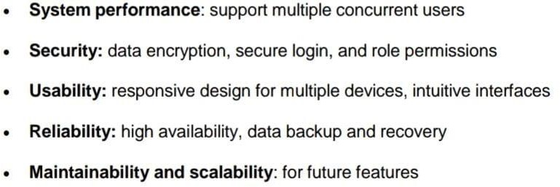
FUNCTIONAL REQUIREMENTS
The hostel management system ensures efficient coordination between students, wardens, and administrators through secure role-based authentication. It allows students to register and track complaints, access digital mess menus, and stay informed about announcements and events through an integrated calendar. The platform also supports fee tracking with secure notifications and profile management for updating personal details. Each user role has a customized dashboard displaying relevant data, while automated email or app notifications keep all users updated on complaints, events, and announcements. Additionally, administrators can export data and generate reports for better monitoring and decision- making.
NON FUNCTIONAL REQUIREMENTS

Slide 16
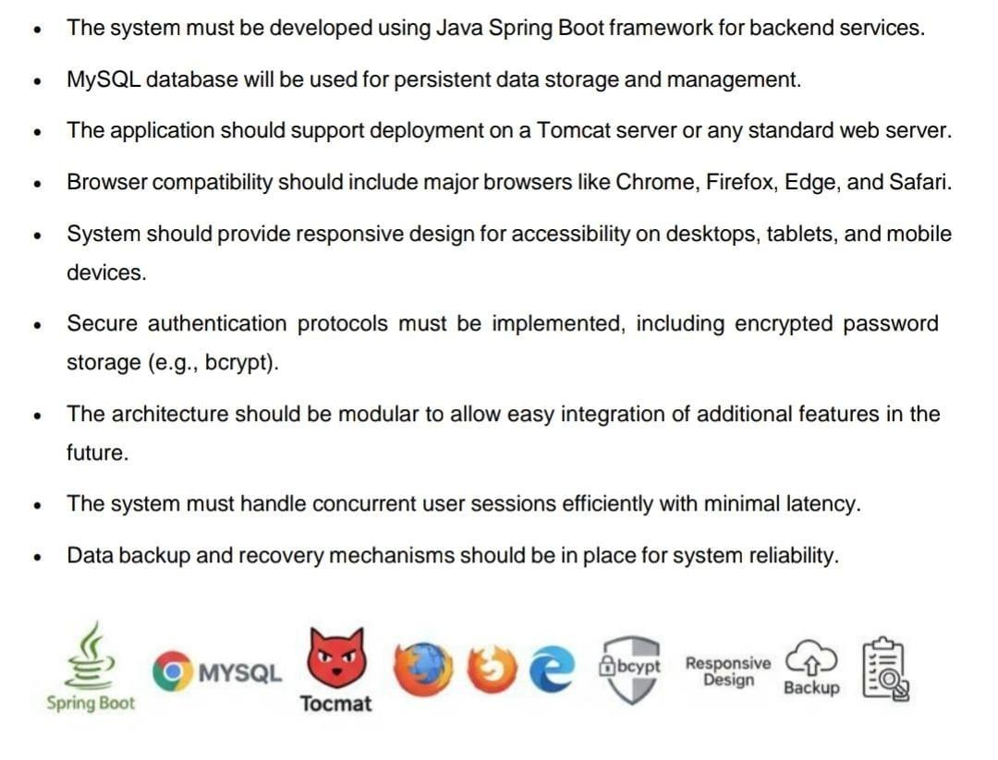
TECHNICAL REQUIREMENTS

Slide 17
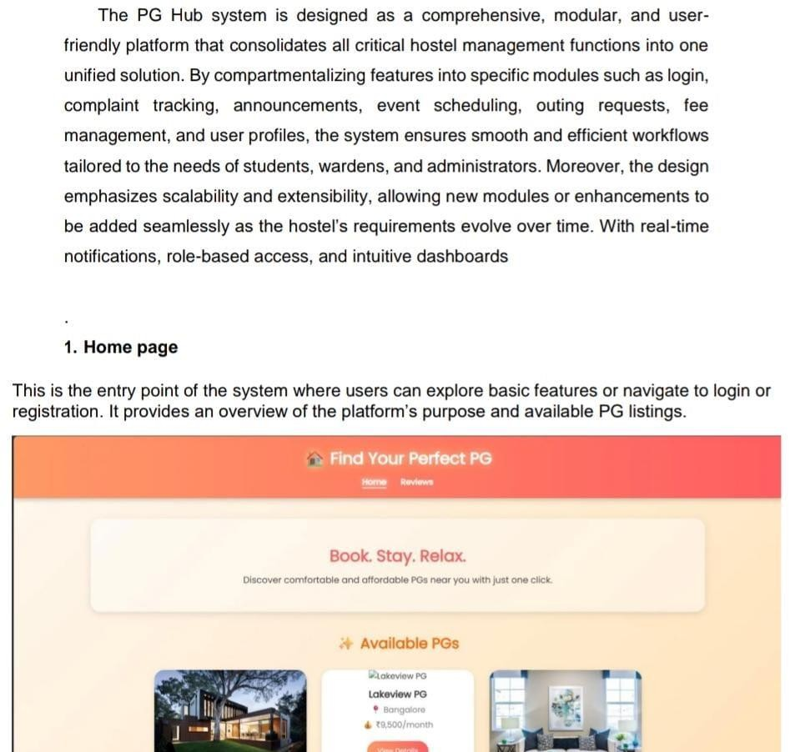
DESCRIPTION OF MODULES AND WORKFLOW

Slide 18
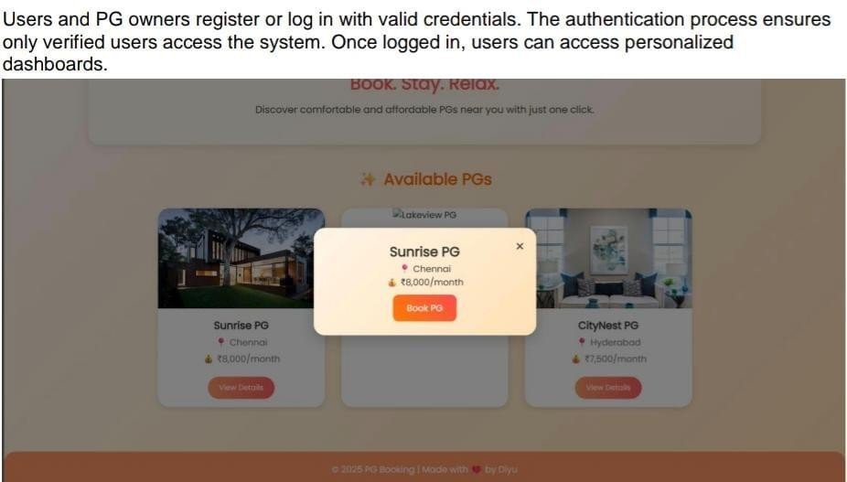
User Registration/Login

Slide 19
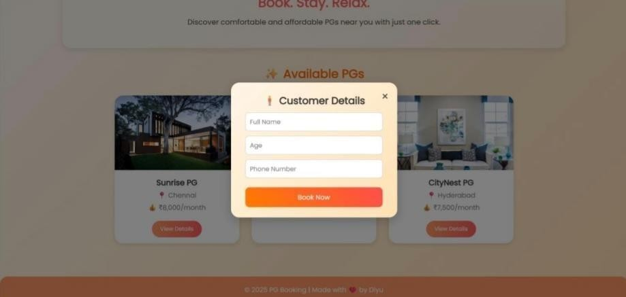
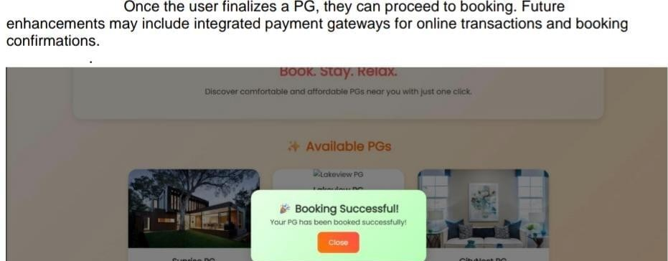
Book PGs

Slide 20
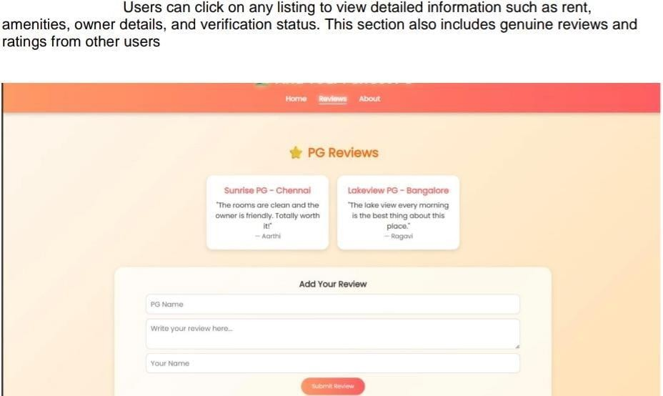
PG review

Slide 21
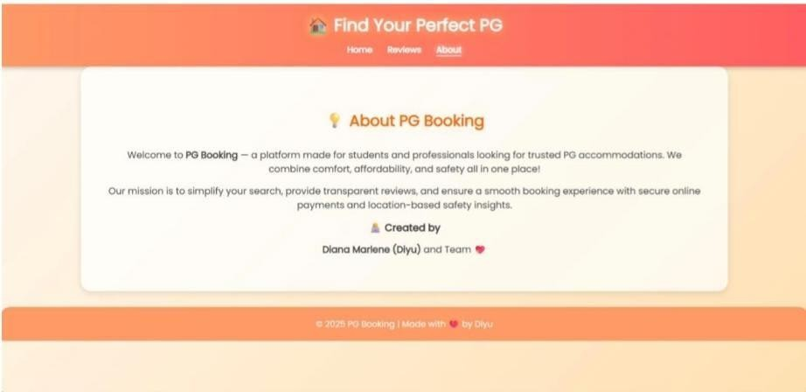
About PG booking

Slide 22
SCALABILITY AND EXTENSIBILITY PLAN
The system is designed to be scalable and easily extendable:
Database Scalability: MySQL supports large datasets, allowing addition of new tables for future features like payment history or maintenance logs.
Code Extensibility: The modular design enables new features—like chat systems or online payments—to be added without disturbing existing modules.
Server Scalability: Hosted on cloud infrastructure, the system can handle increased traffic during peak times.
Cross-Platform Compatibility: The web-based interface ensures smartphones.
SECURITY AND ETHICAL CONSIDERATIONS
accessibility from desktops, tablets, and
Security is crucial as the system stores sensitive student and PG data. To ensure safety, it uses secure login with encryption, protected hosting servers, and regular data backups for recovery. All sensitive information is encrypted before storage, and access is role-based to prevent unauthorized use. Ethical measures include maintaining user privacy, ensuring genuine listings for transparency, and enforcing a no-misuse policy that suspends users involved in fake activities.

Slide 23
LIMITATIONS OF EXISTING SYSTEMS AND FUTURE ENHANCEMENTS
The current system has a few limitations:
Manual Verification Delays: Verification of documents can take time during peak submissions.
Limited Automation: Some processes like fraud detection rely on admin checks.
Lack of Mobile Application: Currently designed for web use; no mobile app yet.
AI-based Recommendation System: Suggest suitable PGs based on user preferences and past searches.
Online Payment Integration: Enable secure transactions and automated billing.
Chatbot Support: For instant customer support and inquiry handling.
.

Slide 24
CONCLUSION
The Verified PG Connect system successfully provides a modern, reliable, and secure digital platform for managing Paying Guest (PG) accommodations. It bridges the gap between PG owners and seekers by enabling transparent communication, verified listings, and easy access to relevant information.
Through the integration of technologies like Java, MySQL, HTML, CSS, and Bootstrap, the system ensures a smooth, responsive, and scalable experience. The verification module enhances trust and safety, while the user-friendly interface allows even non-technical users to navigate effortlessly.
The project emphasizes not only technical efficiency but also data security, ethical responsibility, and user satisfaction. By automating key processes such as verification, search, and complaint handling, it minimizes manual intervention and improves overall reliability.
25

Slide 25
THANK YOU
.

